Slide 1

WEB SCRAPPING AND EDA PROJECT USING PYTHON (FLIPKART)
Presented By:
SEELAMSETTY SAIKEERTHI SUREKHA
BATCH -387(ONLINE BATCH)

Slide 2

TABLE OF CONTENTS
1.About us
2.Business problem and Domain
3.Objective
4.Web Scrapping-Details
5.Summary
6.Exploratory Data Analysis
7.conclusion
8.Actionable insights

Slide 3
ABOUT US
1.Background/Qualification: lB.Tech(Graduate-2025-CSE)
2.Passionate about Trending Domain Data Analysis.
3.Internships :
a. Edunet Foundation: Data Analysis
b. Shadow fox :Data Science
c. Edunet Foundation: Front End Development
4.GitHub:https://github.com/Saikeerthi-3/WebScrapping_EDA_pytthon_filpkart_1
5.Linkdin:https://www.linkedin.com/in/saikeerthi-surekha-seelamsetty/

Slide 4
BUSINESS PROBLEM & DOMAIN
The refrigerator market is vast, with multiple brands, specifications, and price ranges. Customers often struggle to compare features like inverter type, stabilizer support, warranty periods, and pricing. Businesses and analysts can benefit from structured data to understand market trends, pricing strategies, and popular features.
Domain: E-commerce data analysis for consumer electronics (Home Appliances – Refrigerators).
Use Case:
Price and feature comparison for competitive analysis.
Identification of popular specifications for targeted marketing.
Market trend analysis for product positioning.

Slide 5
OBJECTIVE
To scrape real-time product data from Flipkart's Double Door Refrigerator listings, clean and structure the data, and perform Exploratory Data Analysis (EDA) to extract actionable business insights about pricing, ratings, and product features.

Slide 6
WEB SCRAPPING-DETAILS
1.Website Scraped: Flipkart – Double Door Refrigerators
2.Process Followed:
Identify Target Pages: Search results for “double door refrigerator” across multiple pages.
Inspect HTML Structure: Located product name, rating, specifications, warranty details, and price tags.
Set Up Web Scraper: Used requests + Beautiful Soup for HTML parsing.
3.Patterns & Extraction:
Regex for extracting inverter type, stabilizer info, and warranty period.
Captured ratings and prices directly from HTML tags.
4.Anti-Blocking Measures:
Rotated User-Agent headers.
Added random time delays between requests.
Data Storage: Saved extracted data into a CSV file for analysis.

Slide 7
SUMMARY
1.Total Records: 24–39 entries before cleaning, finalized to consistent length for analysis.
2.Columns Collected:
product_name – Refrigerator model/brand name.
inverter – Type of inverter/compressor technology.
Stabilizer – Presence of built-in stabilizer.
Warranty – Warranty duration (including compressor coverage).
Ratings – Average customer rating.
prod_price – Product price (in INR).
3.Data Cleaning: Ensured equal length across columns, handled missing values, standardized formats.

Slide 8
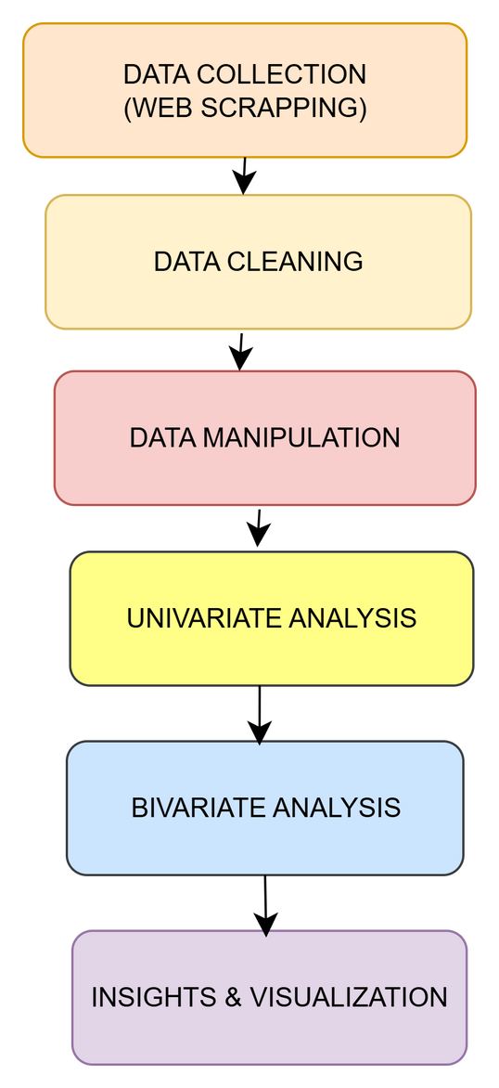
EXPLORATORY DATA ANALYSIS

Slide 9
Data Cleaning
Removed special characters (₹, ,) from price column.
Converted price column to numeric data type for analysis.
Standardized text formats for inverter, stabilizer, and warranty columns.
Ensured equal length of all lists before creating DataFrame.
Handled missing values for ratings and specifications.

Slide 10
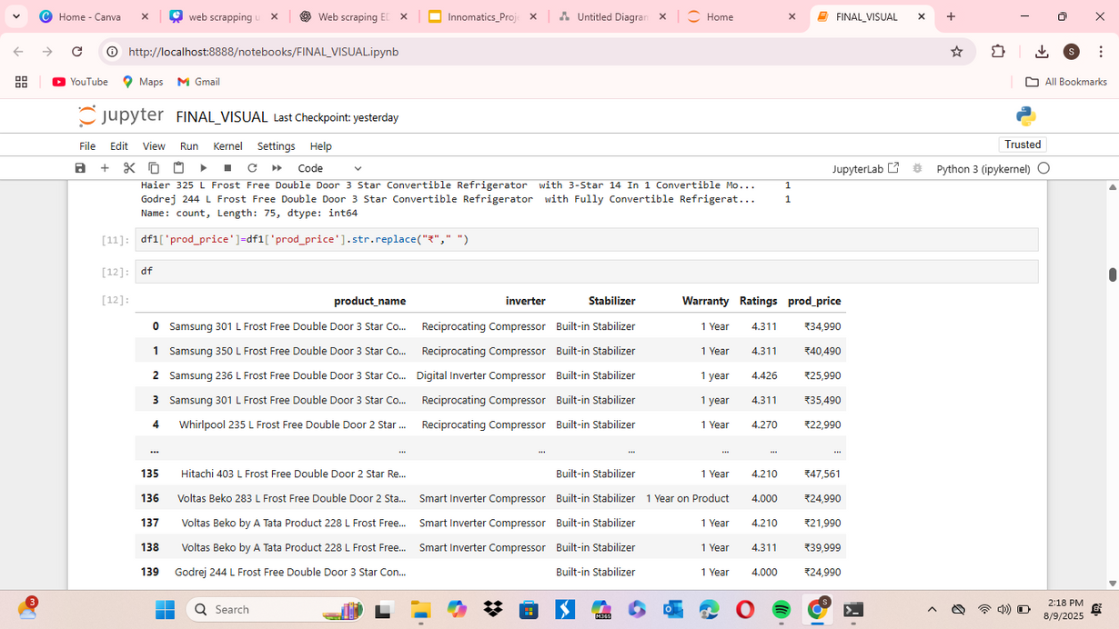
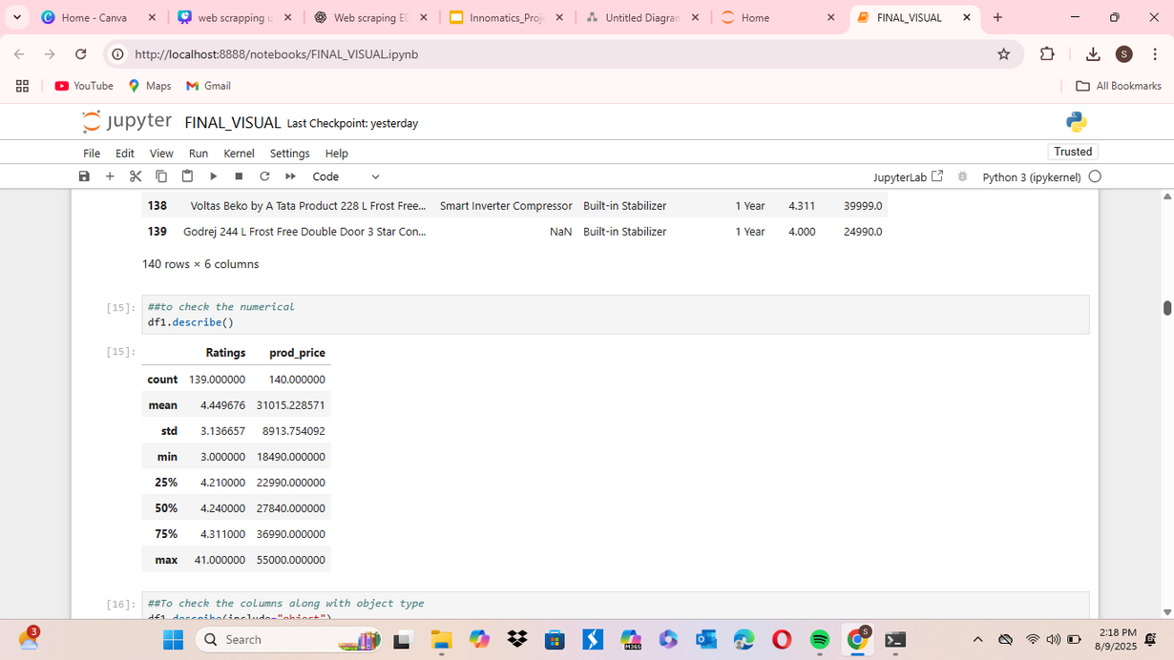
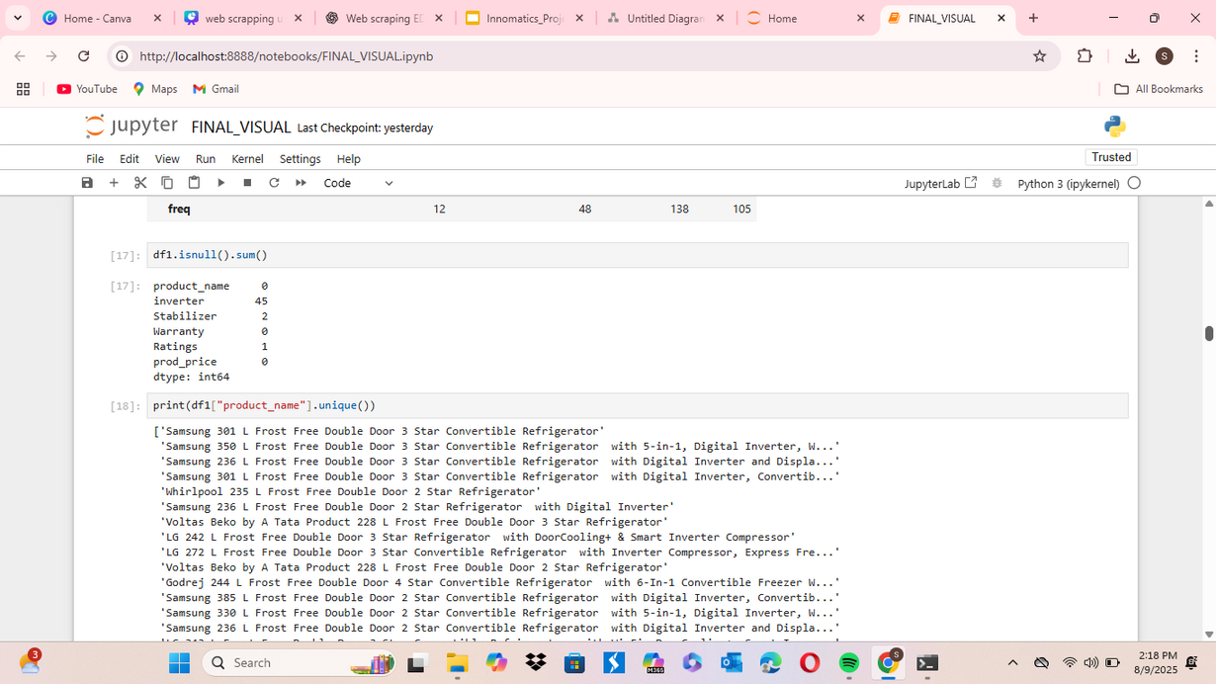

Slide 11
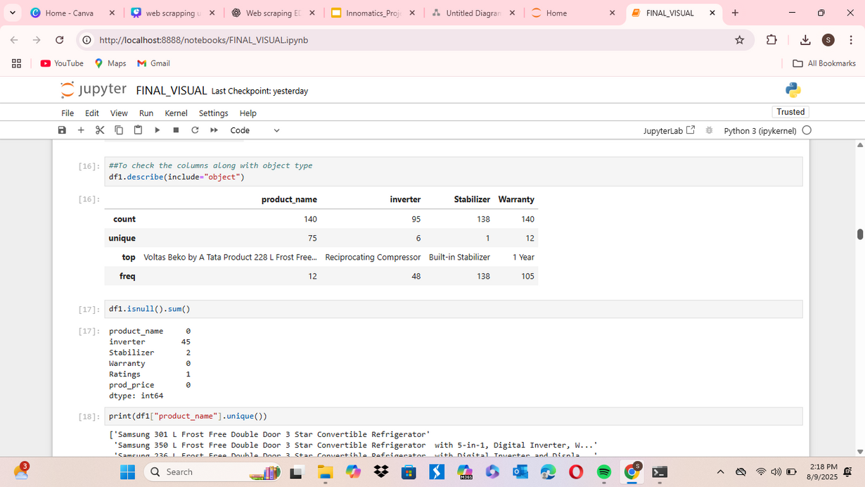
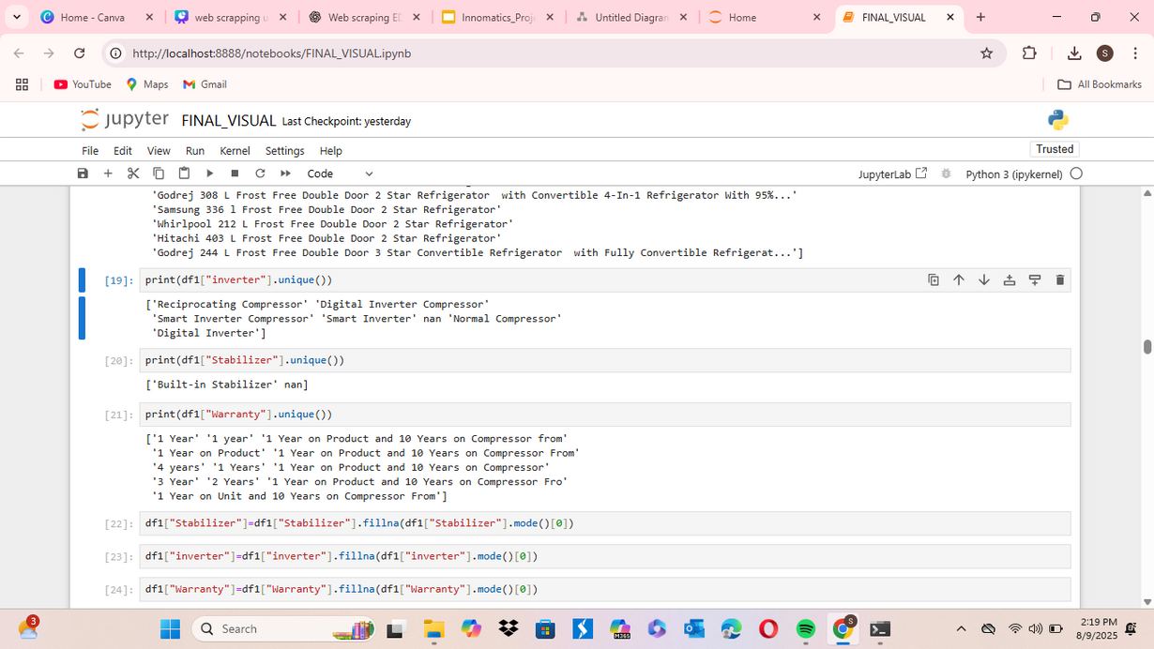
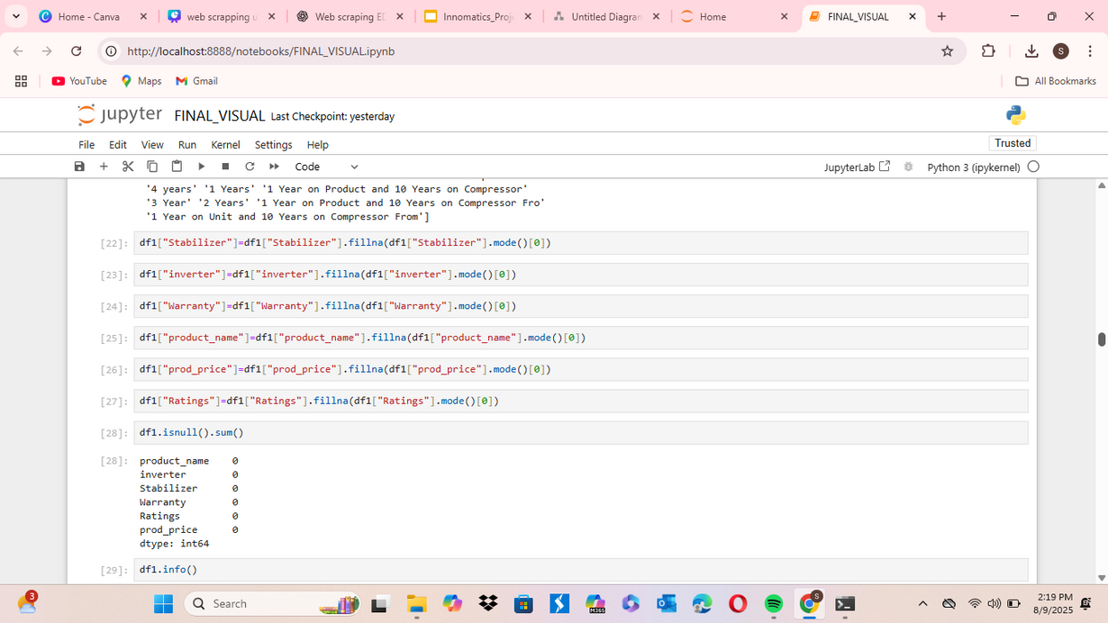

Slide 12
Data Manipulation
Extracted inverter type, stabilizer info, and warranty period using Regex patterns.
Created a clean DataFrame with consistent column naming.
Converted data into CSV for reusability.
Formatted categorical columns for easy grouping and plotting.

Slide 13
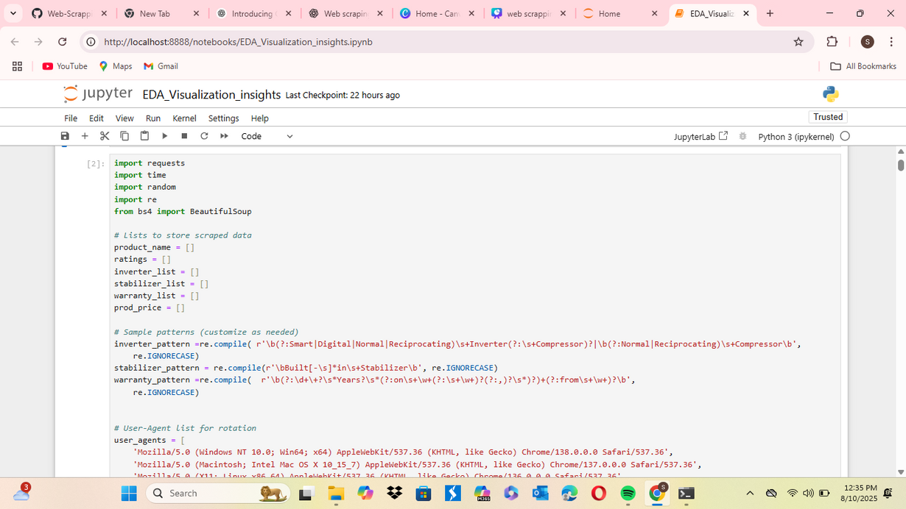
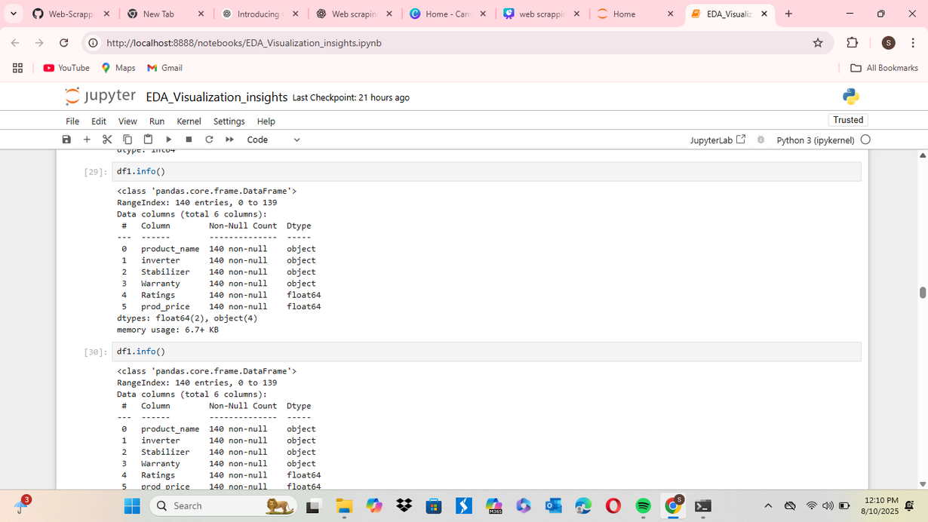
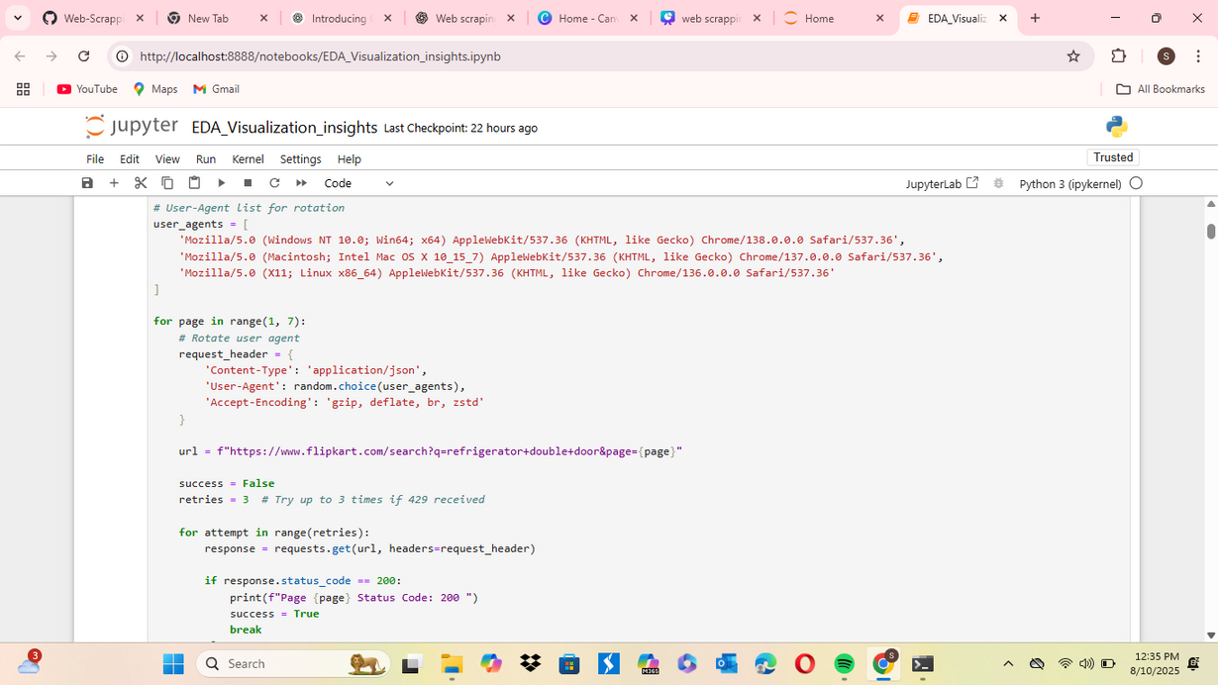

Slide 14
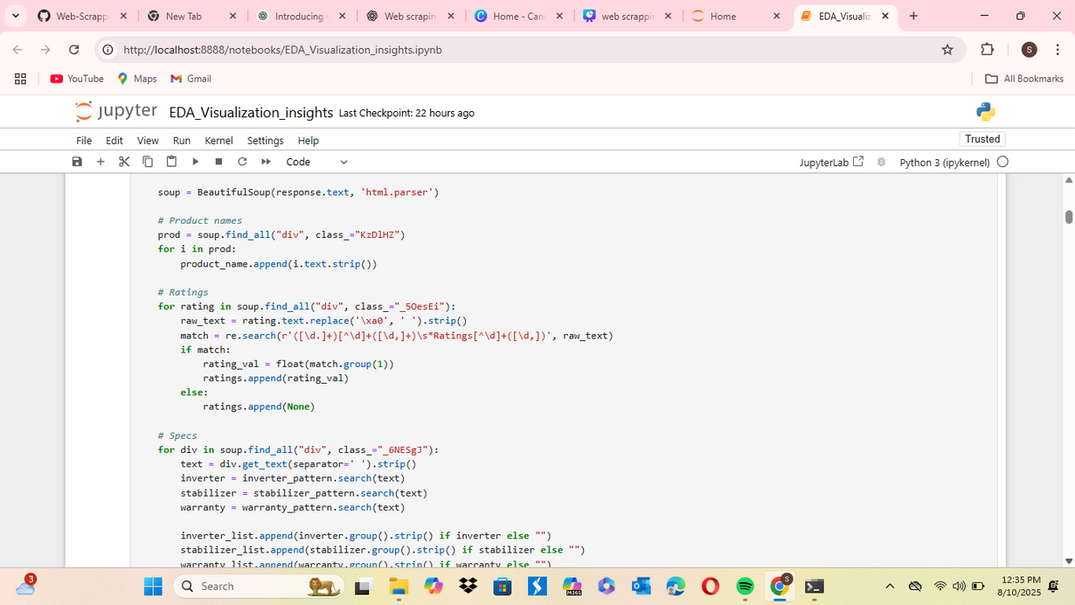
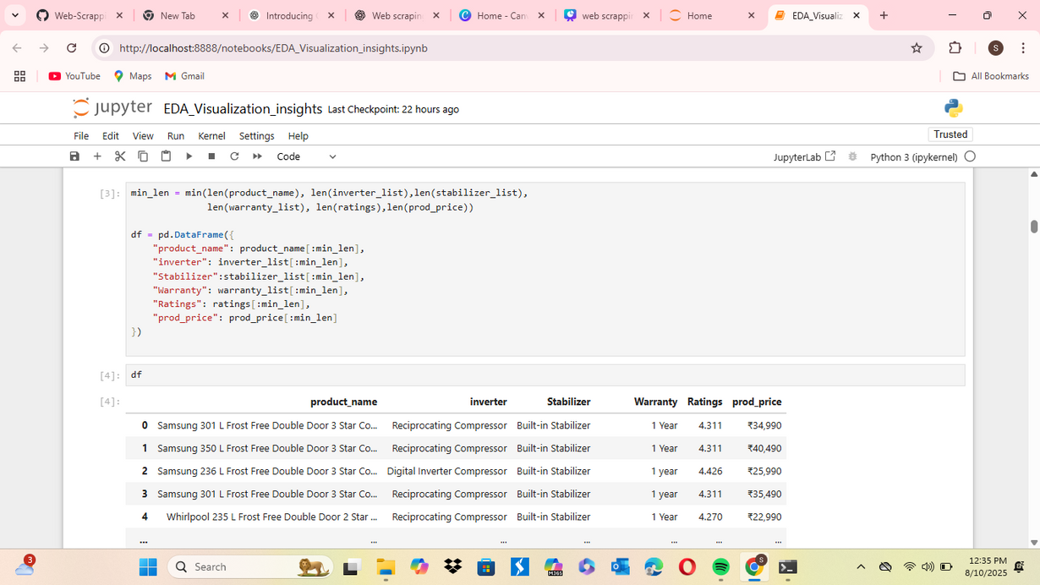
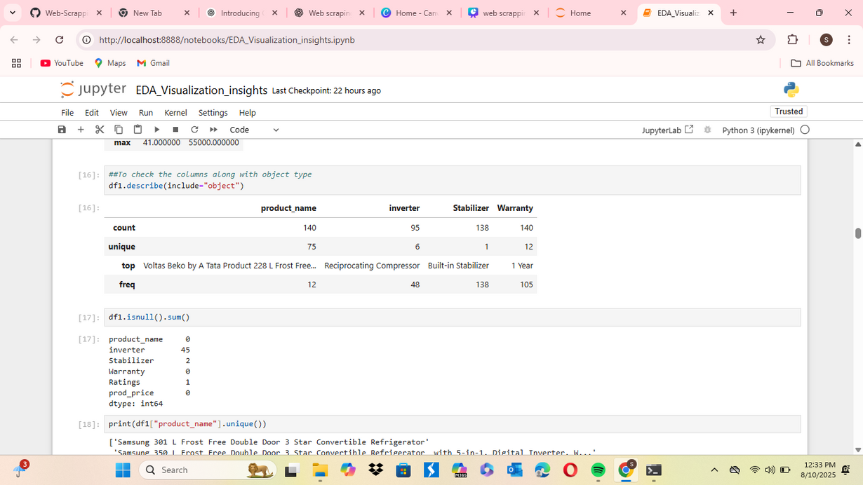

Slide 15
Univariate Analysis Steps
Used value_counts() to see frequency distribution of inverter types, stabilizer presence, and warranty terms.
Used histograms and pie charts to visualize categorical feature distribution.
Analyzed descriptive statistics (mean, median, mode) for prices and ratings.

Slide 16
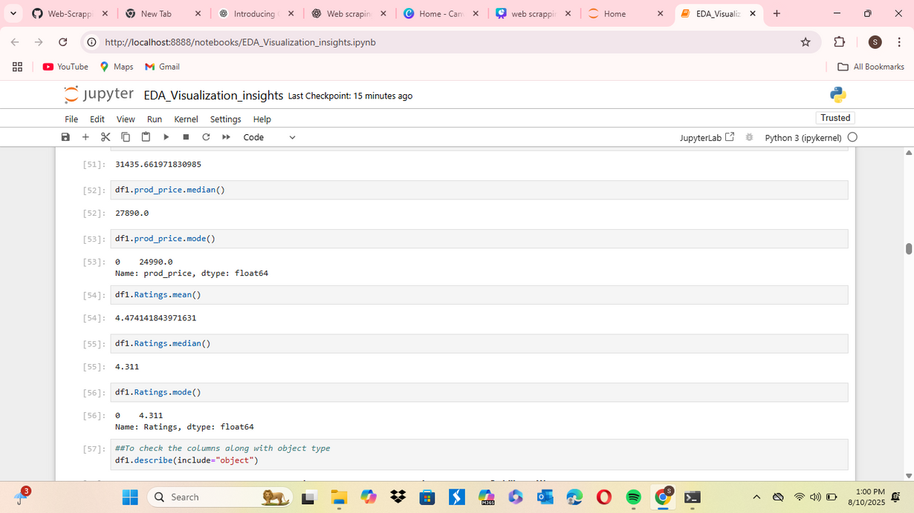
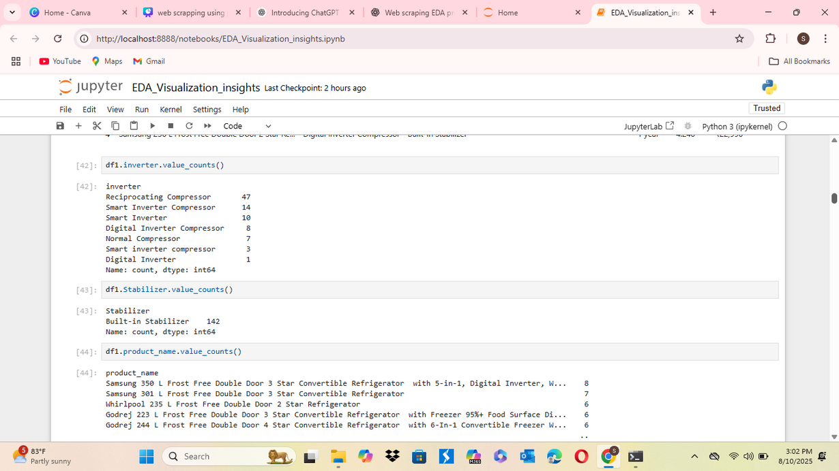
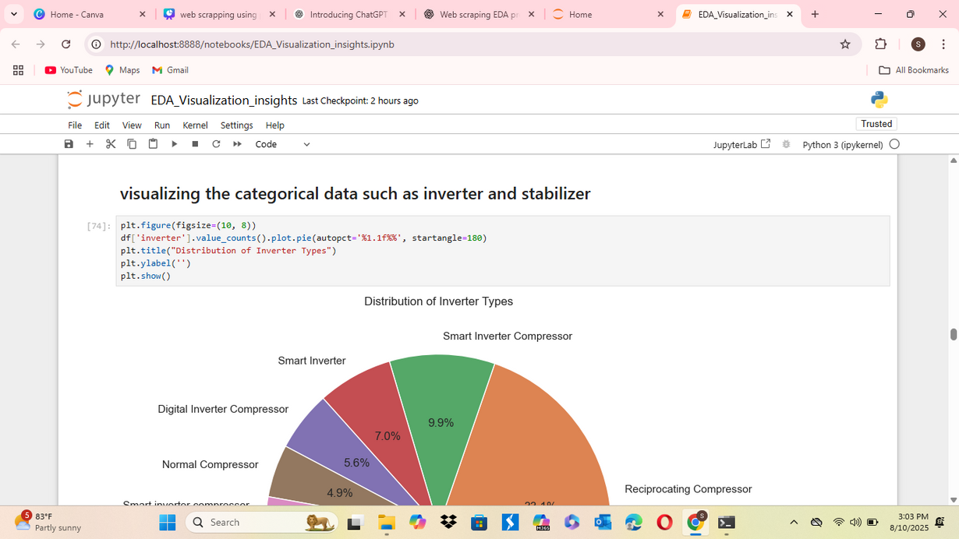
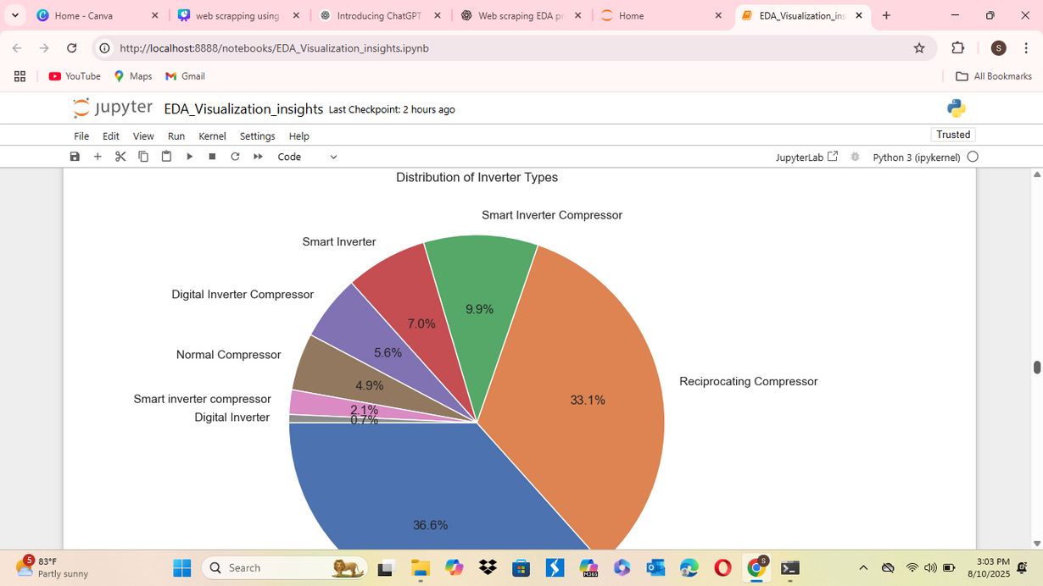

Slide 17
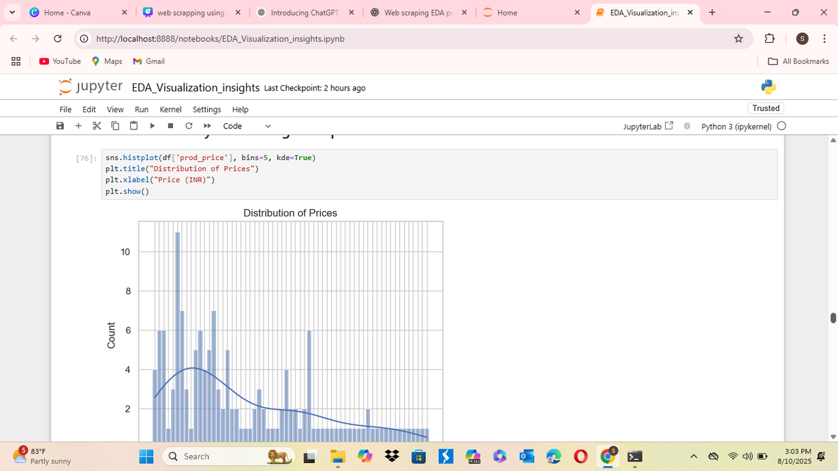
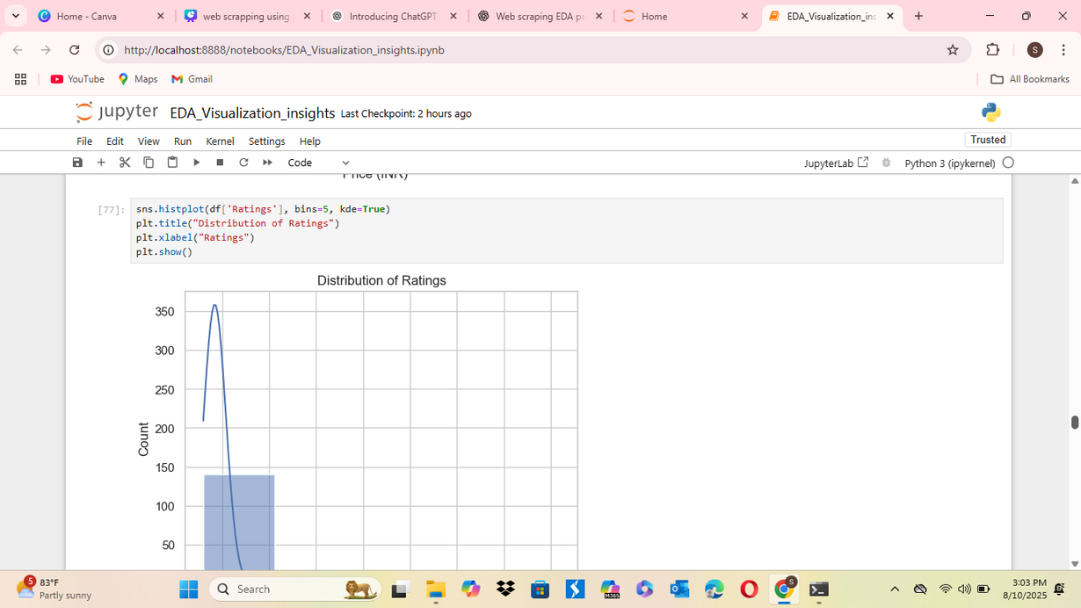
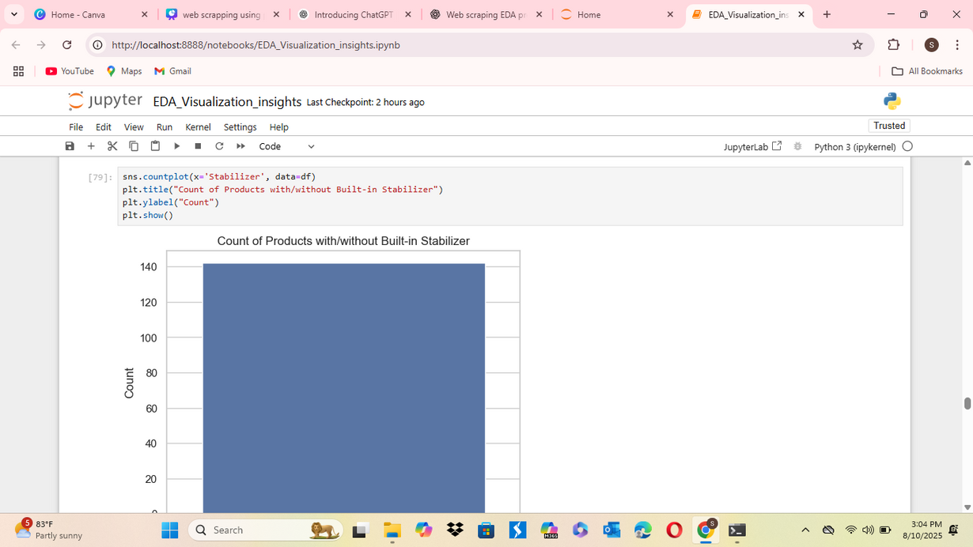

Slide 18
Bivariate Analysis Steps
Compared price vs. rating using scatter plots.
Created bar plots to compare average price by inverter type.
Used grouped aggregations to analyze warranty vs. price and stabilizer vs. rating.
Checked correlations between numeric columns (price, rating).

Slide 19
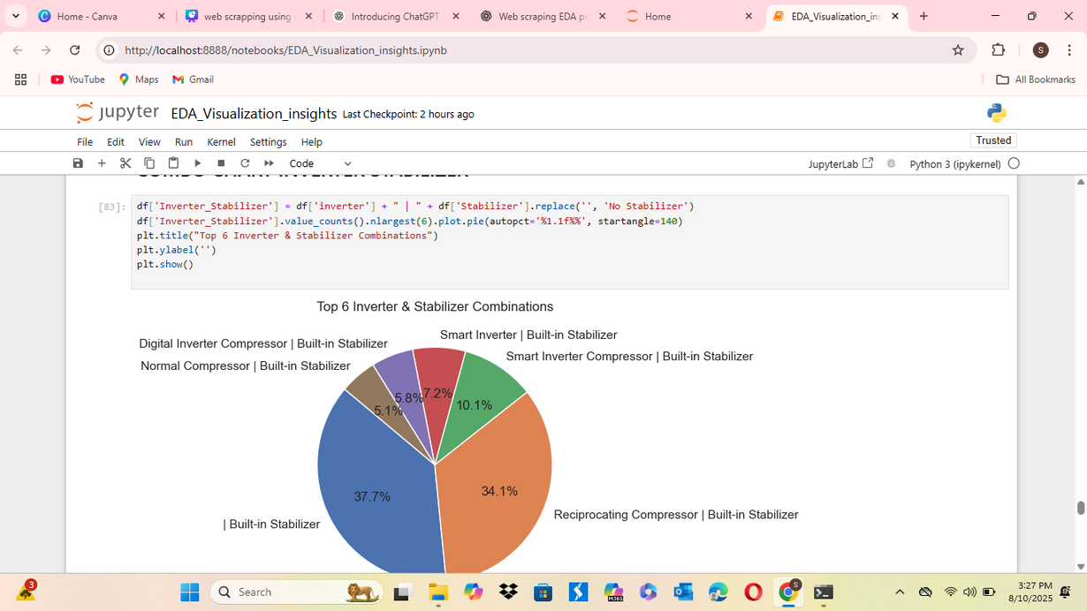
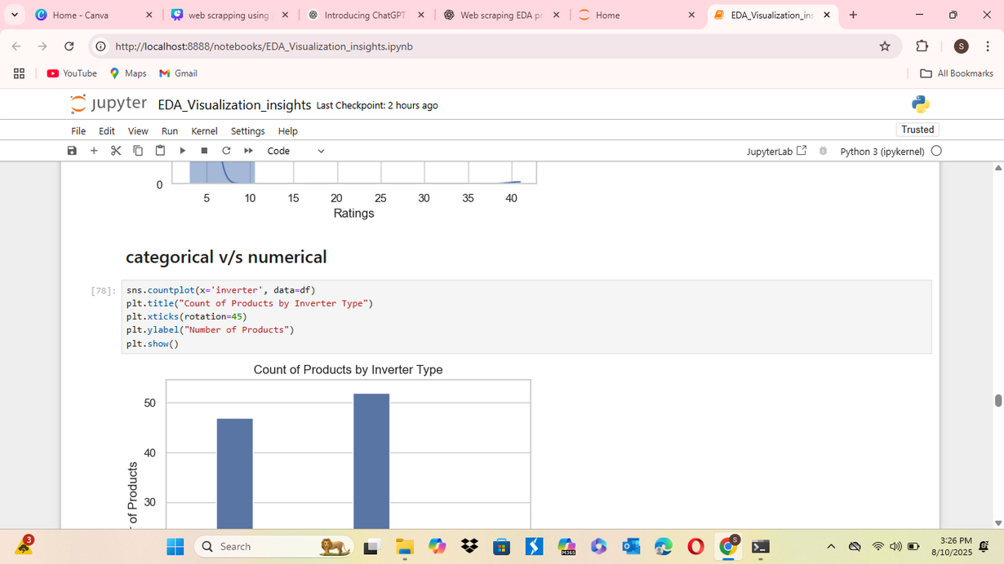
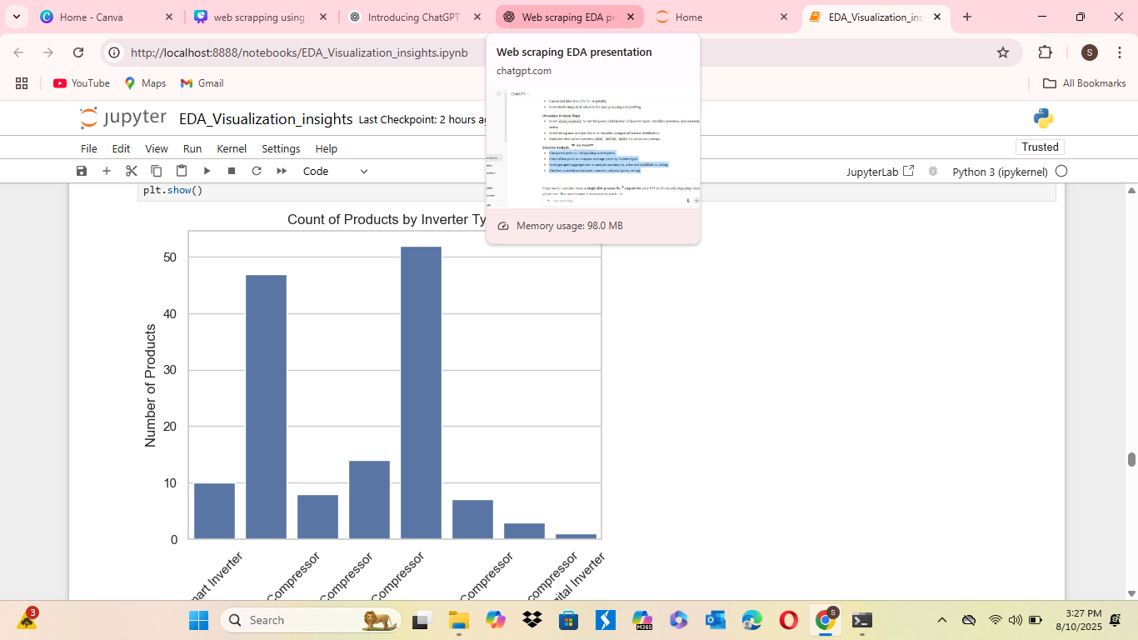
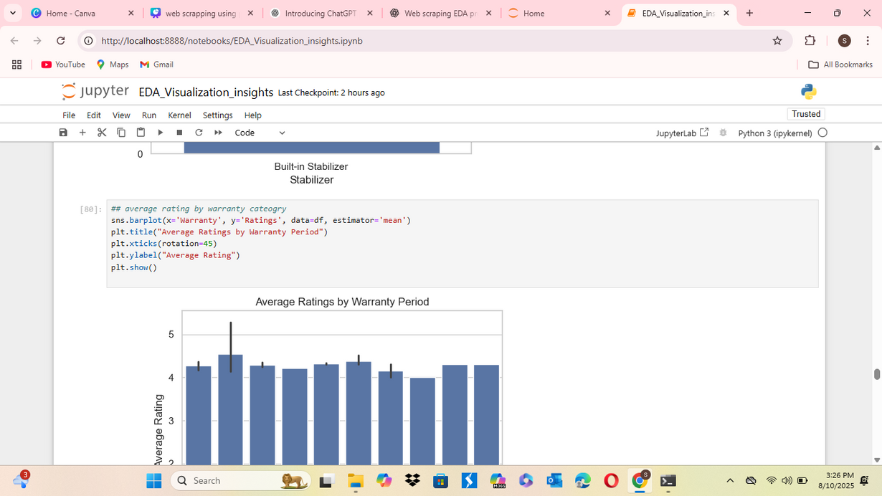

Slide 20
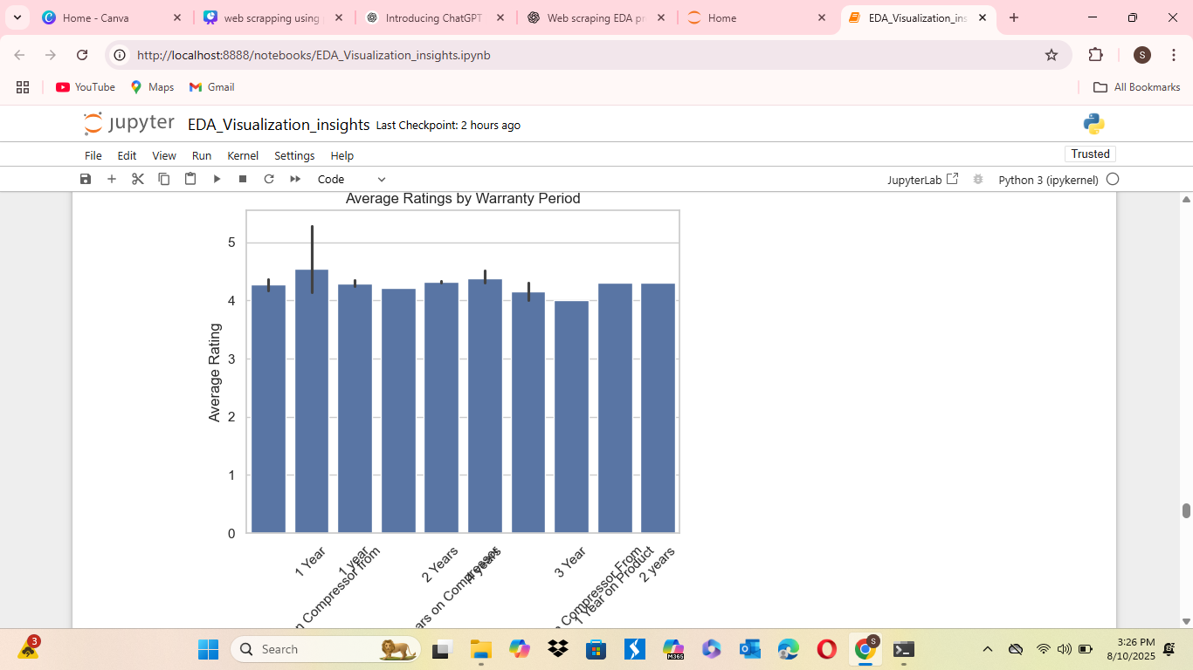
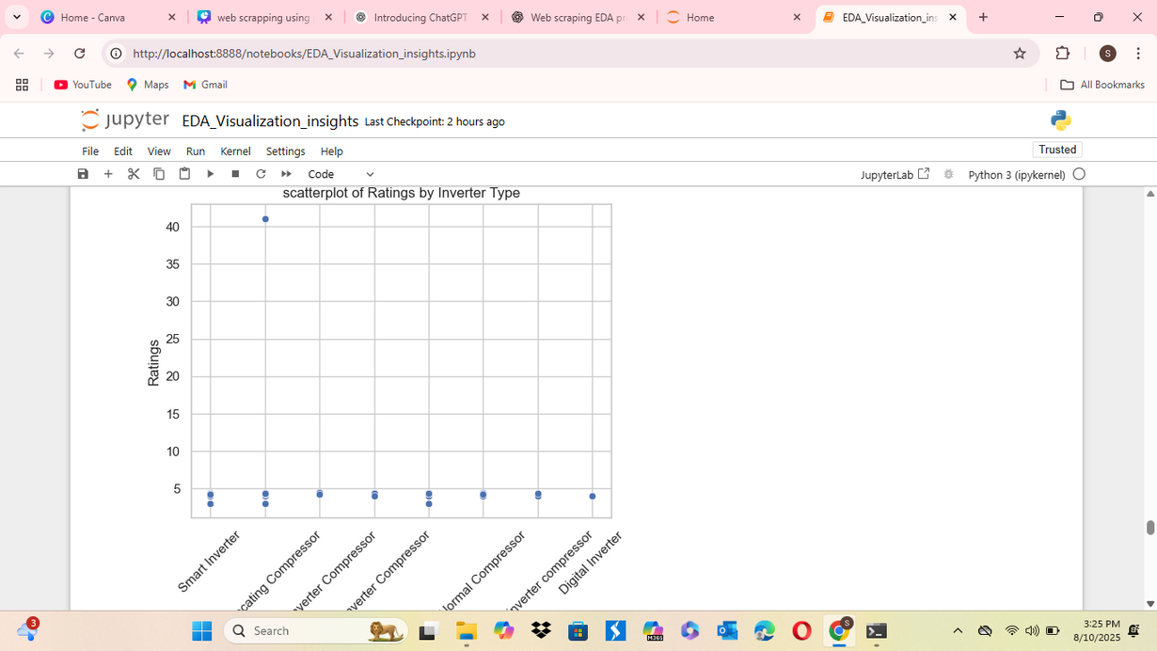
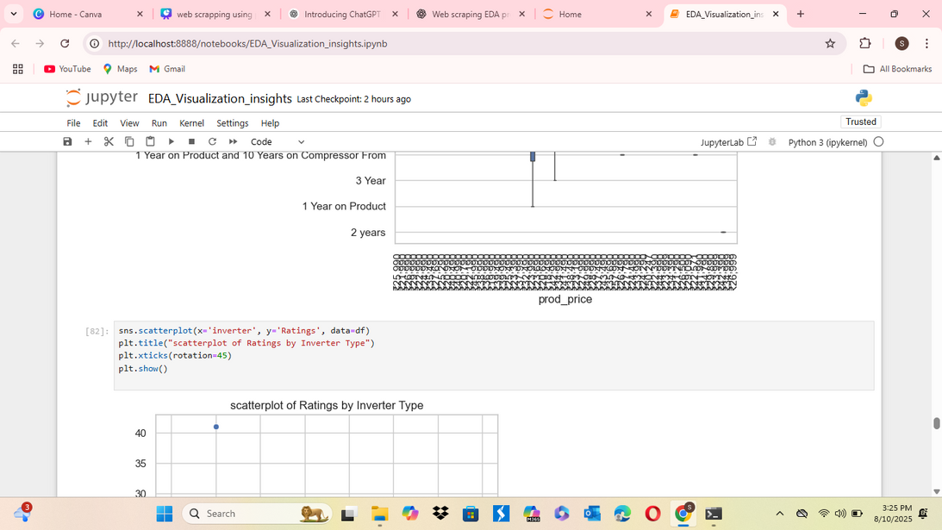

Slide 21
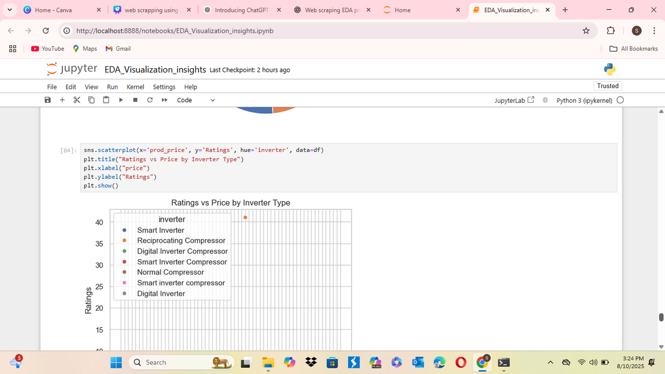
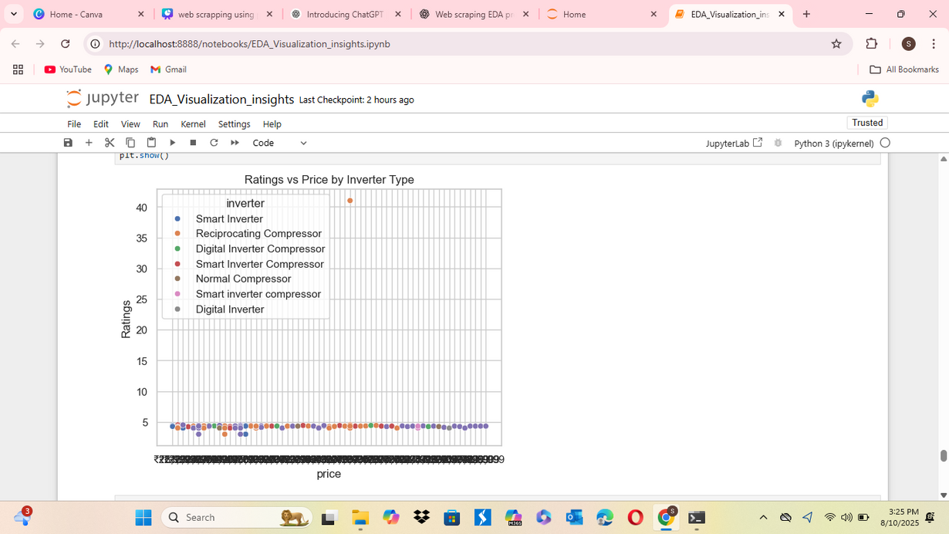
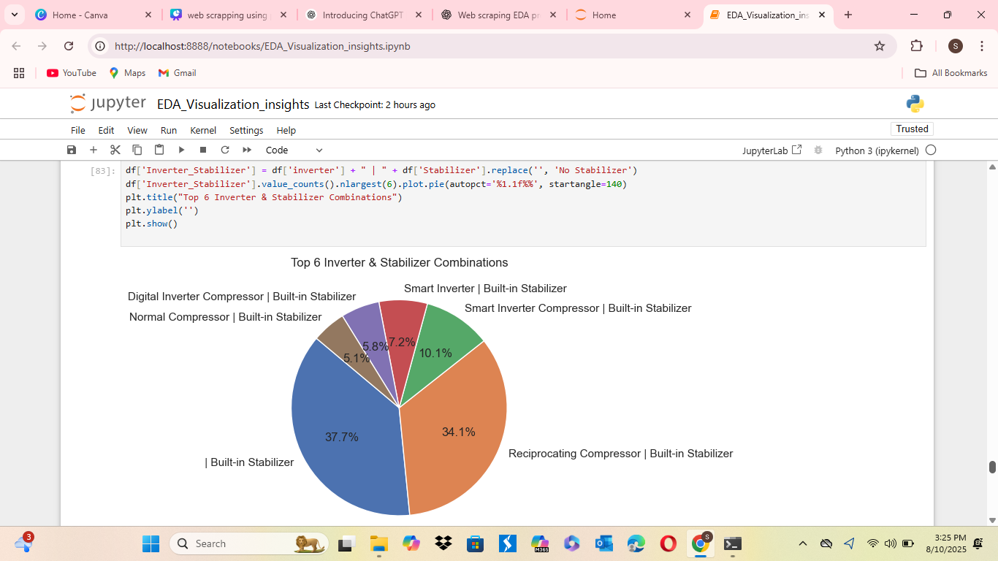

Slide 22
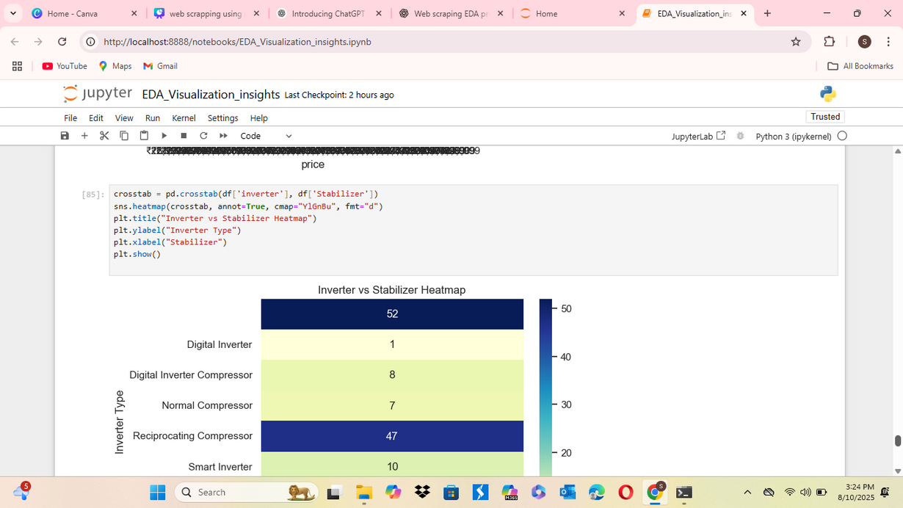
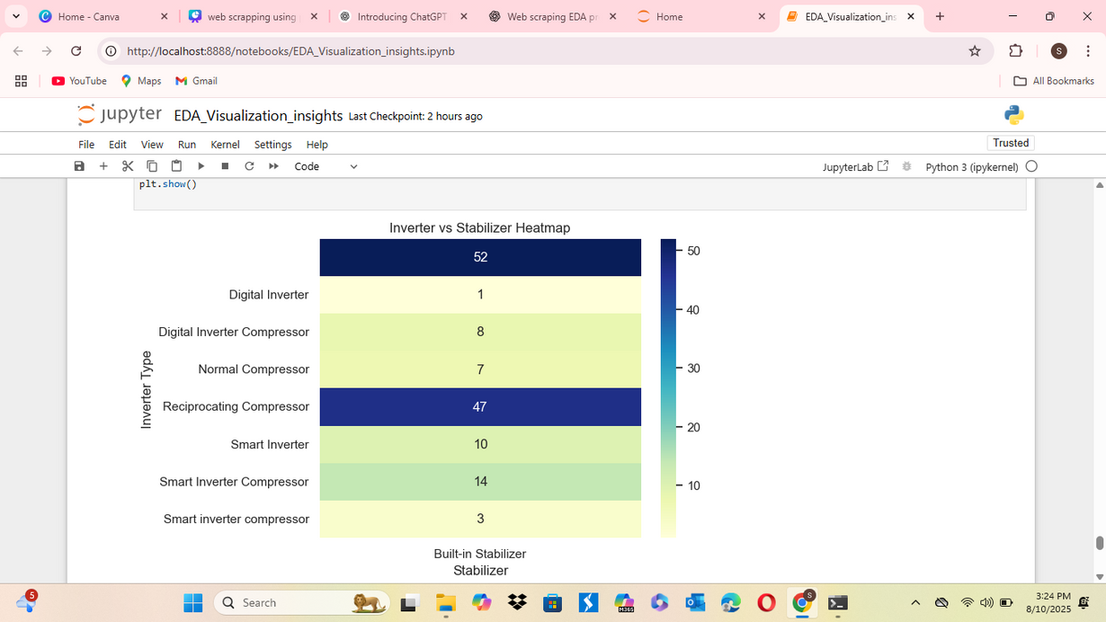
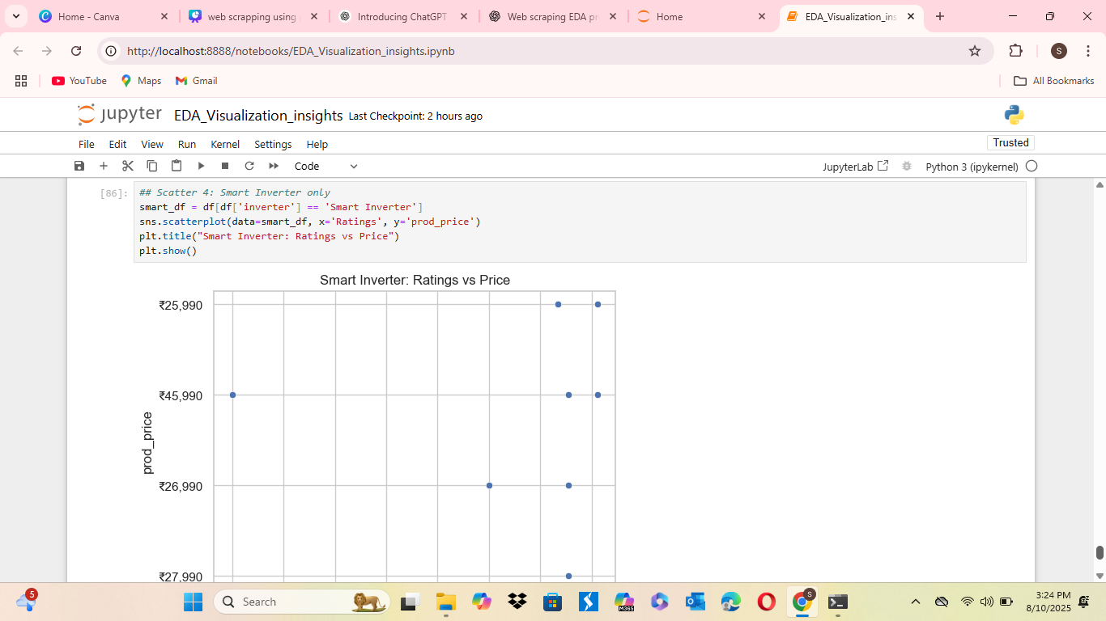

Slide 23
CONCLUSION
This project successfully demonstrates the end-to-end process of extracting and analyzing product data from the Flipkart website through web scraping, followed by comprehensive exploratory data analysis (EDA). By collecting real-time product information such as names, prices, ratings, warranty details, and features, the analysis provided valuable insights into pricing trends, customer preferences, and feature availability. Data cleaning and manipulation ensured accuracy and consistency, while univariate and bivariate analyses helped identify key patterns and relationships. Overall, the project highlights how web scraping combined with EDA can be effectively used to extract market intelligence, support informed decision-making, and understand competitive product landscapes.

Slide 24
ACTIONABLE INSIGHTS
Price Range Optimization – Most products fall within a specific mid-price range, indicating that pricing new products within this band could increase competitiveness.
Customer Preference Trends – Products with higher ratings and more reviews tend to have better visibility, suggesting sellers should encourage verified customer feedback.
Warranty as a Differentiator – Many products offer only a standard warranty; extending warranty duration could be a competitive advantage.
Feature Importance – Certain features (e.g., inverter technology in appliances) are more common in top-rated products, implying they could be a selling point.
Brand Performance – A few brands dominate the top-rated and most-reviewed categories, suggesting partnerships or competitive strategies against these key players.
Discount Strategy – Products with visible discounts tend to rank higher in listings, indicating that strategic discounting could boost sales

Slide 25
THANK YOU

